Slide 1
Compilation Techniques (11)
Code generation for IF, WHILE, SWITCH
Polymorphic functions implementation
VM optimizations
Object code. Linkers
© Codruta-Mihaela ISTIN 2015

Slide 2
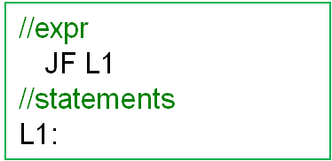
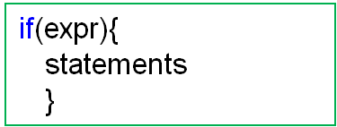
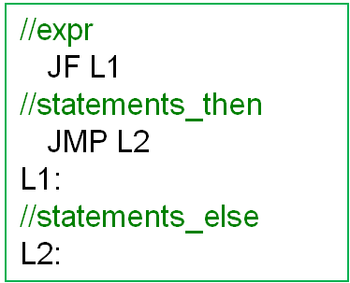
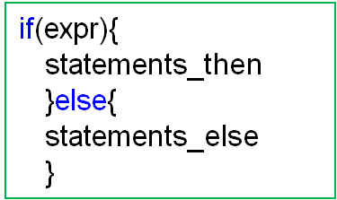
Code generation for IF
© Codruta-Mihaela ISTIN 2015

Slide 3
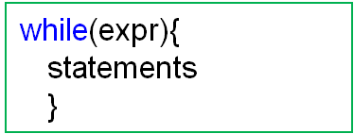
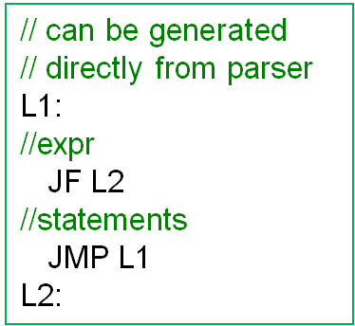
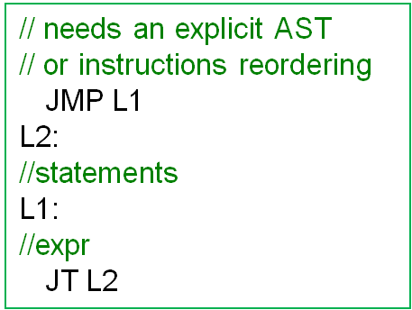
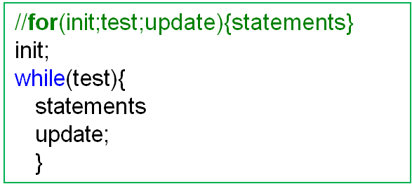
Code generation for WHILE
Which one is better?
© Codruta-Mihaela ISTIN 2015

Slide 4
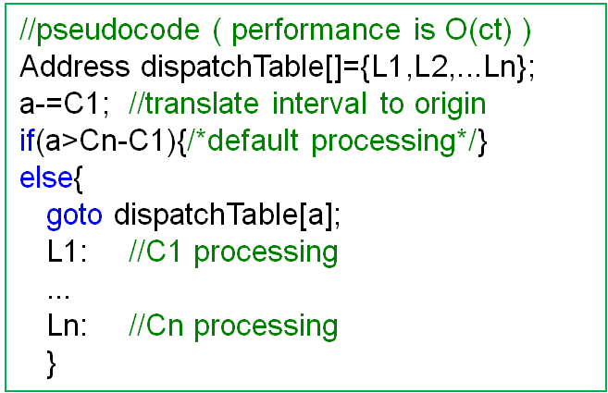
Code generation for SWITCH
If a sequence of “if/else if” is used for many equality tests:
if(a==C1){…}else if(a==C2){…}…else if(a==Cn){…}else{…}
in the worst case n tests must be made ( performance is O(n) )
An improvement is to sort the constants and use a binary search through them. In this case each comparison will reduce the possible choices in half ( performance is O(log₂n) ):
if(a<C_{n/2}){/*search first half*/}else if(a>C_{n/2}){/*search second half*/}else{/*a==C_{n/2}*/}
If C1…Cn are integral and contiguous (or with small gaps), a dispatch table can be used:
© Codruta-Mihaela ISTIN 2015

Slide 5
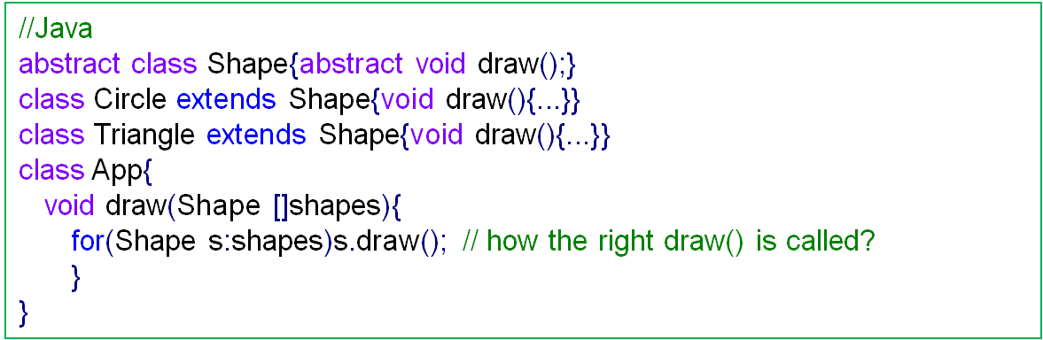
Polymorphic (virtual) functions (1)
Each instance has a hidden member “vtable” (virtual table) which gives the Runtime Type Information (RTTI) for that instance
On “new” the vtable member is initialized with the right vtable for that object type
Each class has its own vtable with all its polymorphic functions. If child classes define new polymorphic functions, these will be added at the end of the existent ones, so the existent order is kept unchanged
Because each virtual method has an unique index (ex: the definition order), this index can be used to retrieve the right method from vtable and call it
Dynamic Typed Languages (DTL) can also use this method to call specific functions on a generic (untyped) object (using string or ids lookups)
This type of call is slower than the one of non-virtual (final) methods because it uses more memory accesses and an indirect call
© Codruta-Mihaela ISTIN 2015

Slide 6
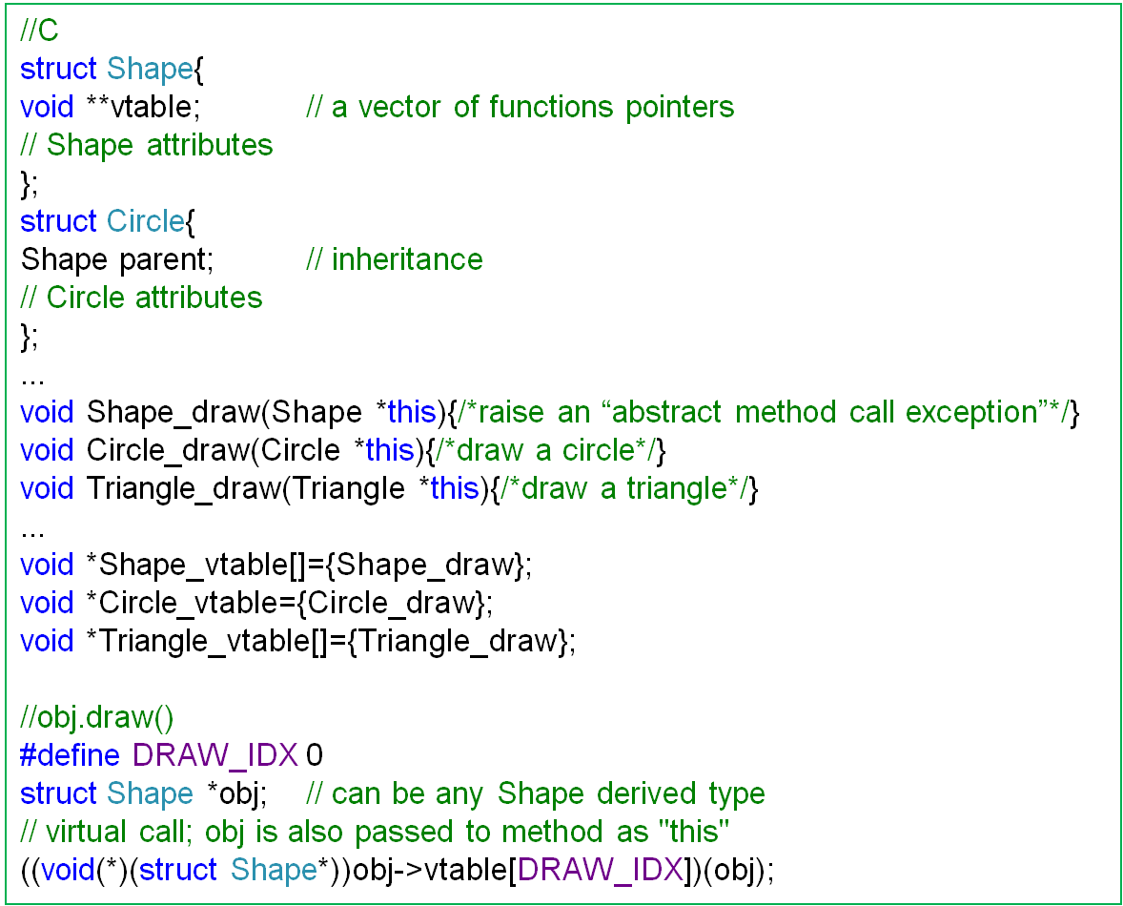
Polymorphic (virtual) functions (2)
© Codruta-Mihaela ISTIN 2015

Slide 7
VM optimizations (1)
VM adds an abstraction layer over the machine code. This layer slows down the execution so some methods are used for speedup (besides compilation to machine code using JIT or AOT compilers)
Optimization by reducing the number of VM instructions – for each VM instruction, in native code a “switch” instruction and a loop back to the “switch” begin are executed
If the same job can be done with less instructions, the number of native “switch/loops” are also reduced, so the speedup is improved
Lowering the number of instructions can be done in some ways:
  by using register based VM (RVM) instead of stack based VM (SVM)
  By defining new instructions for frequent consecutive instructions:
    PUSHADDR &a ; LOAD → PUSH a
    LESS ; JT label -> JLESS label
© Codruta-Mihaela ISTIN 2015

Slide 8
VM optimizations (2)
Optimization by specializing VM instructions – some special forms of an instruction are used frequently; these forms can be specialized in new instructions which are faster than the general ones
Ex: LOAD n // load n bytes from memory to stack; frequently used forms: LOAD 1 (char), LOAD 4 (int, float), LOAD 8 (double)
it can be specialized in: LOAD_C, LOAD_I, LOAD_D
In the general form (LOAD n), a supplementary access to memory needs to be made to retrieve “n”
A particular form (ex: LOAD_I) implicitly defines “n” in its opcode definition, so no memory accesses are needed to know “n”
© Codruta-Mihaela ISTIN 2015

Slide 9
VM optimizations (3)
Optimization by using as much as possible native code – many standard functions (ex: memory management, strings, files, regular expressions) can be provided as predefined functions
If the predefined functions are written in languages which compile to native code (C/C++), these functions run at the microprocessor top speed, so it does not matter the VM speed
Optimization by using compiler dependent features – some compilers extend the C language with different features; these features can be used for VM speedup, but care must be taken to preserve the code portability (if required):
  GCC provides a “computed goto” extension of the “goto” instruction; this extension can take the “goto” address from a variabile, so it can be used to implement dispatch tables (~30% speedup than the “switch” implementation)
  Many C compilers provide a way to specify that the “default” of a “switch” is not used (ex: gcc “default: __builtin_unreachable();”) this allows the compiler to optimize the “switch” code by not testing the “default” case; in this case all opcodes must be valid
© Codruta-Mihaela ISTIN 2015

Slide 10
Object code. Linkers (1)
Object code – the product of compiling a part of a program
Some compilers (ex: C/C++/Java) allow individual source code files compilation to object files (.obj, .o, .class). The object files can be grouped in libraries/archives (.lib, .a, .jar)
The object code (OC) contains references to missing symbols (symbols which are defined elsewhere) and a list with all the defined symbols (which are exported from an OC)
Ex: A C program that contains a reference to “printf” is compiled to OC. In order to obtain the final executable, the “printf” function must be located in the compiler standard libraries and its code must be linked together with OC.
Linking – the phase of combining different OC and library files in order to obtain the complete application
The linking is done by a linker
The linking can be part of the compiling phase or part of the runtime phase
© Codruta-Mihaela ISTIN 2015

Slide 11
Object code. Linkers (2)
C/C++ use a linker as part of the compiling phase and the final executable is produced. The main advantage of this method is that the linkage is done only once and on run the application startup time is very low
Java/C# and DTL use a linker at the runtime. When a new module (class) is loaded its required symbols are found and linked. This step can imply loading of other modules. This method provides more flexibility at runtime (including on-the-fly code generation) but it increases the application startup time.
Linker algorithm:
  the “main” (startup) method is added to the final application
  All the symbols referred from “main” (functions, global variables) are searched in the current OC, the project OCs or the compiler standard libraries
  If a symbol is not found an error is signaled: “linker: symbol not found”
  The referred symbols code/data is added to the final application
  The algorithm repeats with the newly added symbols by also resolving their dependencies
© Codruta-Mihaela ISTIN 2015

Slide 12
Bibliography reading
Compilers. Principles, Techniques and Tools
6.7, 6.8
© Codruta-Mihaela ISTIN 2015

